Slide 1

Recursion
Lecture 8: Oct 22

Slide 2
Plan
Recursion is one of the most important techniques in computer science.
The main idea is to “reduce” a problem into smaller problems.
Setting up recurrences
  Fibonacci recurrence
  Problem solving recurrences
  Catalan recurrences

Slide 3
Recursively Defined Sequences
We can define a sequence by specifying relation between
the current term and the previous terms.
Arithmetic sequence: (a, a+d, a+2d, a+3d, …, )
recursive definition: a₀=a, a_{i+1}=a_{i}+d
Geometric sequence: (a, ra, r²a, r³a, …, )
recursive definition: a₀=a, a_{i+1}=ra_{i}
Harmonic sequence: (1, 1/2, 1/3, 1/4, …, )
recursive definition: a₀=1, a_{i+1}=ia_{i}/(i+1)

Slide 4
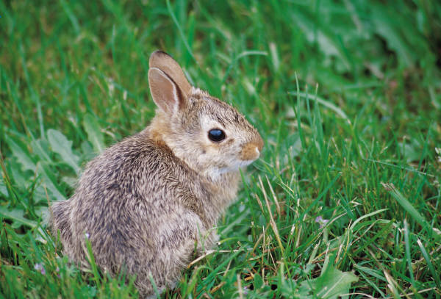
Rabbit Populations
The Rabbit Population
A mature rabbit pair reproduces every month.
Rabbits mature after one month.
w_{n}::= # newborn pairs after n months
r_{n}::= # reproducing pairs after n months
Start with a newborn pair: w₀ =1, r₀ = 0
How many rabbits after n months?

Slide 5
Rabbit Populations
w_{n}::= # newborn pairs after n months
r_{n}::= # reproducing pairs after n months
r₁ = 1
r_{n} = r_{n-1} + w_{n-1}
w_{n} = r_{n-1} so
r_{n} = r_{n-1} + r_{n-2}
It was Fibonacci who was studying rabbit population growth.
We will compute the closed form for r_{n} in the next lecture.

Slide 6
Warm Up
We will solve counting problems by setting up recurrence relations.
First we use recursion to count something we already know,
to get familiar with this approach.
Let us count the number of elements in pow(S_{n})
where S_{n} = {a₁, a₂, …, a_{n}} is an n-element set.
Let r_{n} be the size of pow(S_{n}).
Then r₁ = 2, where pow(S₁) = {Ф, {a₁}}
r₂ = 4, where pow(S₂) = {Ф, {a₁}, {a₂}, {a₁,a₂}}

Slide 7
Warm Up
Let r_{n} be the size of pow(S_{n}) where S_{n} = {a₁, a₂, …, a_{n}} is an n-element set.
Then r₁ = 2, where pow(S₁) = {Ф, {a₁}}
r₂ = 4, where pow(S₂) = {Ф, {a₁}, {a₂}, {a₁,a₂}}
The main idea of recursion is to define r_{n} in terms of the previous r_{i}.
How to define r₃ in terms of r₁ and r₂?
pow(S₃) = the union of {Ф, {a₁}, {a₂}, {a₁,a₂}}
and {a₃, {a₁,a₃}, {a₂,a₃}, {a₁,a₂,a₃}}
So r₃ = 2r₂.
while the lower sets are obtained by adding a₃ to the upper sets.

Slide 8
Warm Up
Let r_{n} be the size of pow(S_{n}) where S_{n} = {a₁, a₂, …, a_{n}} is an n-element set.
The main idea of recursion is to define r_{n} in terms of the previous r_{i}.
pow(S_{n}) = the union of S_{n-1} = {Ф, {a₁}, {a₂}, …, {a₁,a₂,…,a_{n-1}}}
and {a_{n}, {a₁,a_{n}}, {a₂,a_{n}}, …, {a₁,a₂,…,a_{n-1},a_{n}}}
while the lower sets are obtained by adding a_{n} to the upper sets.
Every subset is counted exactly once.
So r_{n} = 2r_{n-1}.
Solving this recurrence relation will show that r_{n} = 2^{n} (geometric sequence).

Slide 9
Number of Bit Strings without a Specific Pattern
How many n-bit string without the bit pattern 11?
Let r_{n} be the number of such strings.
e.g. r₁ = |{0, 1}| = 2,
r₂ = |{00, 01, 10}| = 3
r₃ = |{000, 001, 010, 100, 101}| = 5
r₄ = |{0000, 0001, 0010, 0100, 0101, 1000, 1001, 1010}| = 8
Can you see the pattern?
r₄ = |{0000, 0001, 0010, 0100, 0101} union
{1000, 1001, 1010}|
= 5 + 3 = 8

Slide 10
Number of Bit Strings without a Specific Pattern
How many n-bit string without the bit pattern 11?
Let r_{n} be the number of such strings.
How do we compute it using r₁,r₂,…,r_{n-1}?
Case 1: The first bit is 0.
Then any (n-1)-bit string without the bit pattern 11
can be appended to the end to form a n-bit string without 11.
So in this case there are exactly r_{n-1} such n-bit strings.
00000000000000000
00000000000000001
…
1010101010101010101
The set of all (n-1)-bit
strings without 11.
Totally r_{n-1} of them.
0
+

Slide 11
Number of Bit Strings without a Specific Pattern
How many n-bit string without the bit pattern 11?
Let r_{n} be the number of such strings.
How do we compute it using r₁,r₂,…,r_{n-1}?
Case 2: The first bit is 1.
Then the second bit must be 0, because we can’t have 11.
Then any (n-2)-bit string without the bit pattern 11
can be appended to the end to form a n-bit string without 11.
So in this case there are exactly r_{n-2} such n-bit strings.
0000000000000000
0000000000000001
…
101010101010101010
The set of all (n-2)-bit
strings without 11.
Totally r_{n-2} of them.
10
+

Slide 12
Number of Bit Strings without a Specific Pattern
How many n-bit string without the bit pattern 11?
00000000000000000
00000000000000001
…
1010101010101010101
The set of all (n-1)-bit
strings without 11.
Totally r_{n-1} of them.
0
+
0000000000000000
0000000000000001
…
101010101010101010
The set of all (n-2)-bit
strings without 11.
Totally r_{n-2} of them.
10
+
Every string without the bit pattern 11 is counted exactly once.
Therefore, r_{n} = r_{n-1} + r_{n-2}

Slide 13
Exercise
How many n-bit string without the bit pattern 111?

Slide 14
Domino
Given a 2xn puzzle, how many ways to fill it with dominos (2x1 tiles)?
E.g. There are 3 ways to fill a 2x3 puzzle with dominos.
Let r_{n} be the number of ways to fill a 2xn puzzle with dominos.
How do we compute it using r₁,r₂,…,r_{n-1}?

Slide 15
Domino
Given a 2xn puzzle, how many ways to fill it with dominos (2x1 tiles)?
Let r_{n} be the number of ways to fill a 2xn puzzle with dominos.
Case 1: put the domino vertically
r_{n-1} to fill the remaining 2x(n-1) puzzle
Case 2: put the domino horizontally
r_{n-2} to fill the remaining 2x(n-2) puzzle
Therefore, r_{n} = r_{n-1} + r_{n-2}

Slide 16
Plan
Setting up recurrences
  Fibonacci recurrence
  Problem solving recurrences
  Catalan recurrences

Slide 17
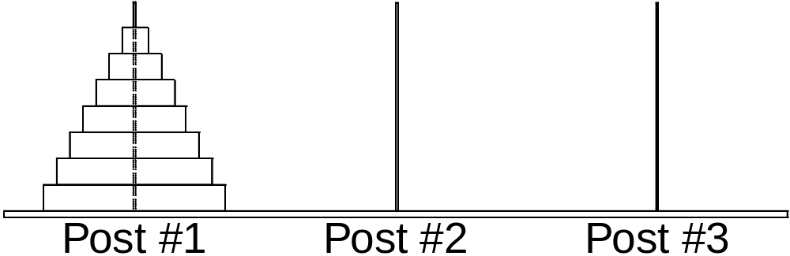
Tower of Hanoi
The goal is to move all the disks to post 3.
The rule is that a bigger disk cannot be placed on top of a smaller disk.

Slide 18
Tower of Hanoi
It is easy if we only have 2 disks.
A total of 3 steps.

Slide 19
Tower of Hanoi
It is not difficult if we only have 3 disks.
Continue in next page

Slide 20
Tower of Hanoi
It is not difficult if we only have 3 disks.
A total of seven steps.

Slide 21
Tower of Hanoi
Can you write a program to solve this problem?
Think recursively!

Slide 22
Tower of Hanoi
Suppose you already have a program for 3 disks.
Can you use it to solve 4 disks?
In order to move the largest disk,
I have to move the top 3 disks first,
and I can use the program for 3 disks.
Then I move the largest disk.
Then I can use the program to move
the 3 disks from pole 2 to pole 3.
Since the program requires 7 steps,
the total number of steps is 15.

Slide 23
Tower of Hanoi
This recursion is true for any n.
In order to move the largest disk,
I must move the top n-1 disks first,
and I can use the program for n-1 disks.
Then I move the largest disk.
Then I can use the program again to move
the n-1 disks from pole 2 to pole 3.
Since the program requires r_{n-1} steps,
the total number of steps is 2r_{n-1} + 1.
r_{n} = 2r_{n-1} + 1

Slide 24
Exercise
Can we use fewer steps if we have 4 poles?
What if we have a constraint that a disk cannot move between pole 1 and pole 3?
How many steps are needed in this case?

Slide 25
Merge Sort
Given a sequence of n numbers,
how many steps are required to sort them into non-decreasing order?
One way to sort the number is called the “bubble sort”,
in which every step we search for the smallest number,
and move it to the front.
This algorithm could take up to roughly n²/2 steps.
For example, if we are given the reverse sequence n,n-1,n-2,…,1.
Every time it will search to the end to find the smallest number,
and the algorithm takes roughly n+(n-1)+(n-2)+…+1 = n(n+1)/2 steps.
Can we design a faster algorithm?
Think recursively!

Slide 26
Merge Sort
Suppose we have a program to sort n/2 numbers.
We can use it to sort n numbers in the following way.
3 8 4 7 2 1 6 5
Divide the sequence into two halves.
Use the program to sort the two halves independently.
3 4 7 8
1 2 5 6
With these two sorted sequences of n/2 numbers,
we can merge them into a sorted sequence of n numbers easily!

Slide 27
Merge Sort
Claim. Suppose we have two sorted sequence of k numbers.
We can merge them into a sorted sequence
of 2k numbers in 2k steps.
Proof by example:
3 5 7 8 9 10
1 2 4 6 11 12
To decide the smallest number in the two sequences,
we just need to look at the “heads” of the two sequences.
So, in one step, we can extend the sorted sequence by one number.
So the total number of steps for 2k numbers is 2k.

Slide 28
Merge Sort
3 5 7 8 9 10
1 2 4 6 11 12
1
3 5 7 8 9 10
1 2 4 6 11 12
1 2
3 5 7 8 9 10
1 2 4 6 11 12
1 2 3
3 5 7 8 9 10
1 2 4 6 11 12
1 2 3 4
3 5 7 8 9 10
1 2 4 6 11 12
1 2 3 4 5
3 5 7 8 9 10
1 2 4 6 11 12
1 2 3 4 5 6
3 5 7 8 9 10
1 2 4 6 11 12
1 2 3 4 5 6 7
3 5 7 8 9 10
1 2 4 6 11 12
1 2 3 4 5 6 7 8
3 5 7 8 9 10
1 2 4 6 11 12
1 2 3 4 5 6 7 8 9
3 5 7 8 9 10
1 2 4 6 11 12
1 2 3 4 5 6 7 8 9 10
3 5 7 8 9 10
1 2 4 6 11 12
1 2 3 4 5 6 7 8 9 10 11
3 5 7 8 9 10
1 2 4 6 11 12
1 2 3 4 5 6 7 8 9 10 11 12

Slide 29
Merge Sort
Claim. Suppose we have two sorted sequence of k numbers.
We can merge them into a sorted sequence
of 2k numbers in 2k steps.
Suppose we can sort k numbers in T_{k} steps.
Then we can sort 2k numbers in 2T_{k} + 2k steps.
Therefore, T_{2k} = 2T_{k} + 2k.
If we solve this recurrence (which we will do later),
then we see that T_{2n} ≈ n log₂ n.
This is significantly faster than bubble sort!

Slide 30
Remark
This is one example of a “divide and conquer” algorithm.
This idea is very powerful.
It can be used to design faster algorithms for some basic problems
such as integer multiplications, matrix multiplications, etc.
More on that in CSC 3160.

Slide 31
Plan
Setting up recurrences
  Fibonacci recurrence
  Problem solving recurrences
  Catalan recurrences

Slide 32
Parenthesis
How many valid ways to add n pairs of parentheses?
E.g. There are 5 valid ways to add 3 pairs of parentheses.
((())) (()()) (())() ()(()) ()()()
Let r_{n} be the number of ways to add n pairs of parentheses.
How do we compute it using r₁,r₂,…,r_{n-1}?

Slide 33
Parenthesis
How many valid ways to add n pairs of parentheses?
Let r_{n} be the number of ways to add n pairs of parentheses.
Case 1:
()--------------------
So there are r_{n-1} in this case.
r_{n-1} ways to add the remaining n-1 pairs.
Case 2:
(--)------------------
So there are r_{n-2} in this case.
1 way to add 1 pair
r_{n-2} ways to add the remaining n-2 pairs.
Case 3:
(----)----------------
So there are 2r_{n-3} in this case.
2 ways to add 2 pairs
r_{n-3} ways to add the remaining n-3 pairs.

Slide 34
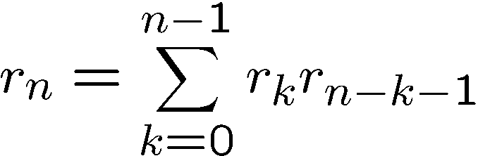
Parenthesis
How many valid ways to add n pairs of parentheses?
Let r_{n} be the number of ways to add n pairs of parenthese.
Case k:
(----------)----------
r_{k} ways to add k pairs
r_{n-k-1} ways to add the remaining n-k-1 pairs.
By the product rule, there are r_{k}r_{n-k-1} ways in case k.
The cases are depended on the position of the matching
close parenthesis of the first open parenthesis,
and so these cases are disjoint.
Therefore, by the sum rule,

Slide 35
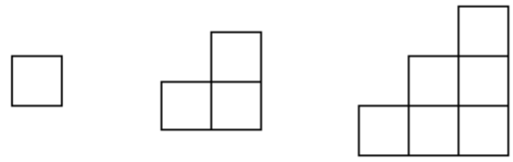

Stairs
An n-stair is the collection of squares (x,y) with x >= y.
For example 1-stair, 2-stair, and 3-stair are like this:
How many ways to fill up the n-stair by exactly n rectangles??
For example, there are 5 ways to fill up the 3-stair by 3 rectangles.

Slide 36
Stairs
Let r_{n} be the number of ways to fill the n-stair by n rectangles.
How do we compute it using r₁,r₂,…,r_{n-1}?
6
5
4
3
2
1
Given the n-stair, the first observation is that the positions on the
diagonal (red numbers) must be covered by different rectangles.
Since there are n positions in the diagonal and we can only use n rectangles,
each rectangle must cover exactly one red number.

Slide 37
Stairs
Let r_{n} be the number of ways to fill the n-stair by n rectangles.
How do we compute it using r₁,r₂,…,r_{n-1}?
6
5
4
3
2
1
o
Consider the rectangle R that covers the bottom right corner (marked with o).
We consider different cases depending on which red number that R contains.

Slide 38
Stairs
Let r_{n} be the number of ways to fill the n-stair by n rectangles.
How do we compute it using r₁,r₂,…,r_{n-1}?
6
5
4
3
2
1
o
Suppose R contains 3. Then observe that the 6-stair is divided into 3 parts.
One part is the rectangle R. The other two parts are a 2-stair and a 3-stair.
Therefore, in this case, the number of ways to fill in the remaining parts
is equal to r₂r₃

Slide 39
Stairs
Let r_{n} be the number of ways to fill the n-stair by n rectangles.
How do we compute it using r₁,r₂,…,r_{n-1}?
6
5
4
3
2
1
o
Similarly suppose R contains 2.
Then the rectangle “breaks” the stair into a 1-stair and a 4-stair.
Therefore, in this case, the number of ways to fill in the remaining parts
is equal to r₁r₄

Slide 40
Stairs
Let r_{n} be the number of ways to fill the n-stair by n rectangles.
How do we compute it using r₁,r₂,…,r_{n-1}?
n
…
…
i
…
1
o
In general suppose the rectangle contains i
Then the rectangle “breaks” the stair into a (i-1)-stair and a (n-i)-stair.
Therefore, in this case, the number of ways to fill in the remaining parts
is equal to r_{i-1}r_{n-i}

Slide 41
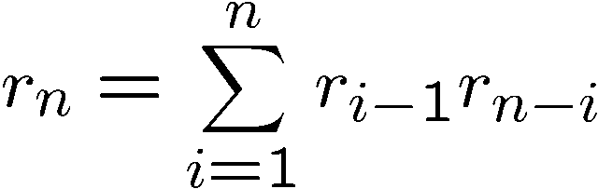
Stairs
The number of ways to fill in the remaining parts is equal to r_{i-1}r_{n-i}
n
…
…
i
…
1
o
Rectangle R containing different i will form different configurations,
and each configuration must correspond to one of these cases.
Therefore the total number of ways is equal to

Slide 42
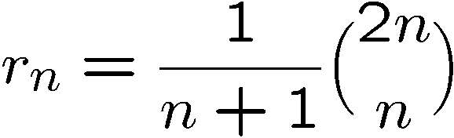
Catalan Number
How many valid ways to add n pairs of parentheses?
It turns out that r_{n} has a very nice formula:
Unfortunately we won’t derive it in this lecture.
This is called the Catalan number.
There are many combinatorial applications of this formula.

